Slide 1
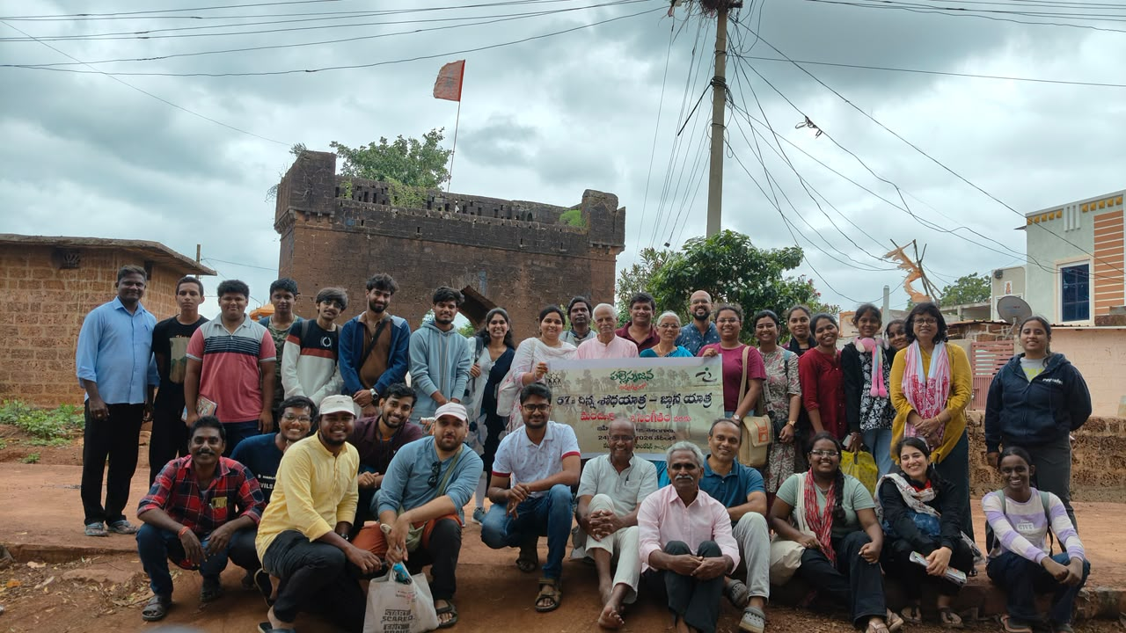
👣🌿 𝑪𝒉𝒊𝒏𝒏𝒂 𝑺𝒉𝒐𝒅𝒉𝒂𝒚𝒂𝒕𝒓𝒂 🌿👣

Slide 2
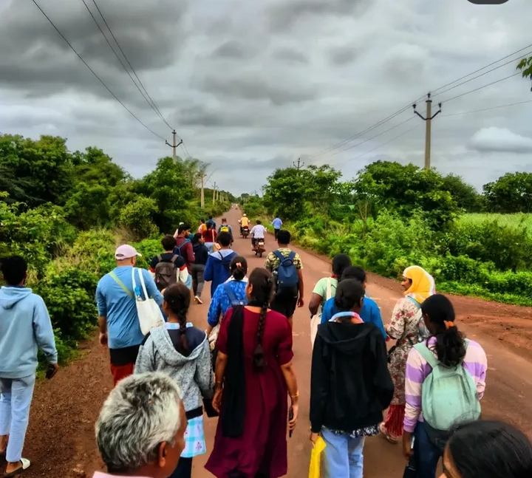
Day 1 – My Impression 🌿👣
On the first day, I was a little curious and nervous about how the Shodhayatra would be and what kind of people I would meet. 😅 Finally, we reached the starting point. By the time we arrived, most of the participants had already introduced themselves, so we also introduced ourselves to everyone.
After understanding the instructions, we took a group photo and started our journey. 📸
Usually, I don't talk much with new people, but during the Yatra, I managed to interact with around 5–6 new people. That itself was a new experience for me, as I slowly started coming out of my comfort zone.
One of the most special experiences of the day was meeting innovator Modha Shiva Kumar Garu and getting to know his story. He developed technology to make weavers' lives easier, and listening to his journey directly from him was truly inspiring. It was actually my first time experiencing something like this—meeting an innovator in person and hearing their story directly from them. It made me realize that innovation is not just about creating something new; it can also make a real difference in people's lives. 🌱✨
Overall, Day 1 was a new experience filled with new people, inspiring stories, and new learnings. I learned many things, met wonderful people, and experienced something completely different from my everyday life. By the end of the day, I was quite tired, and the moment I lay down, I fell asleep almost immediately. 😂😴
Day 1 was definitely a beautiful and memorable start to my Shodhayatra journey! ❤️👣
👣 Our First Steps Together ✨

Slide 3
Day 2 – My Impression 🌿🚜
Day 2 started a little differently. I usually wake up late, but that morning I had to wake up at 6:30 AM and get ready early. 😅 At that moment, I felt a little sad and even thought, “I want to go home.”But since going home wasn’t an option, I decided to stay and continue the Yatra.
My friends were all interacting with the village people and enjoying the experience, while I was feeling a little dull and quiet. But then I saw a tractor! 🚜 I got a chance to go on around four tractor rides, and somehow all my sadness disappeared. 😂 From that moment, I completely switched into happy mode! ❤️
Later, I saw a Blue Spark water well for the first time, which was another new experience for me.
At night, we visited a temple where a Jagaran was taking place. Everyone there took very good care of us and made us feel comfortable. That night was especially special to me because I genuinely felt blessed by Lord Hanuman. 🙏❤️
Day 2 taught me that sometimes our mood can change completely because of the smallest and simplest experiences. From feeling like I wanted to go home in the morning to ending the day feeling blessed and happy—that change itself became one of my favourite memories of the Yatra. 🌿✨

Slide 4
Day 3 – My Impression 🌿❤️
Day 3 started with everyone waking up and getting ready. I also got ready, and by the time we came back, almost everyone had finished their breakfast. We quickly completed ours and gathered for a charcha session on “Excess is Success.” I was able to participate in the discussion to some extent, and then we started our journey for the day.
But somewhere in my mind, I already had the feeling that the Yatra was going to end soon, and I would miss everyone. So, I tried to spend as much time as possible with everyone and enjoy every remaining moment. ❤️
One of the most inspiring moments for me was getting to know Praveen Anna's story. Learning how he kept aside many aspects of his personal life and dedicated years of his time to society and innovation was truly inspiring. His journey gave me a lot to think about and motivated me in many ways.
Finally, we reached our destination and had lunch. Then we all gathered for the last session of the Yatra, where everyone shared their impressions. I also shared my experience wholeheartedly. I genuinely enjoyed speaking and sharing my feelings, and receiving a few compliments made that moment even more special. 🥹❤️
But the most unforgettable moment for me was when Praveen Anna called me closer, shook my hand, and encouraged me to speak confidently and communicate well. The way he appreciated and blessed me with encouraging words is something I will always remember. 🙏✨
Finally, we exchanged Instagram IDs, and phone numbers, trying to take a little piece of the memories and friendships with us. After taking one final group photo, we officially ended our beautiful Shodhayatra journey. 📸👣
What started with a little fear and curiosity ended with beautiful memories, new friendships, inspiration, confidence, and a heart full of happiness. ❤️🌿 This Yatra will always remain one of my most memorable and unforgettable experiences.

Slide 5
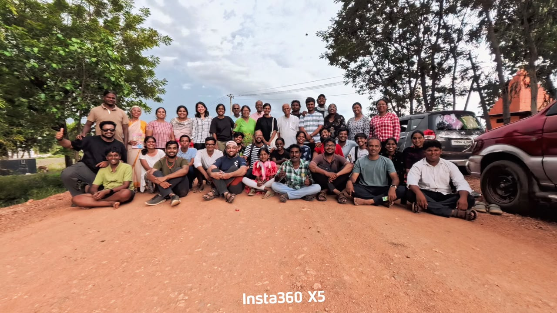
✨ Three Days, Countless Memories, Endless Learnings ✨

